Slide 1
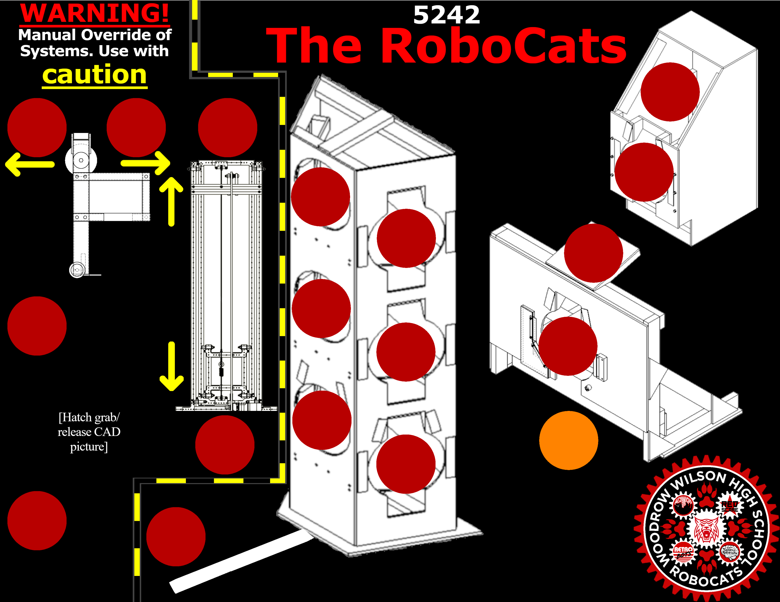
286, 26
5, 42
50, 42
90, 42
274, 61
131, 72
169, 91
252, 97
131, 122
5, 129
169, 141
240, 138
131, 172
90, 182
240, 180
169, 191
5, 216
67, 223

